Slide 1
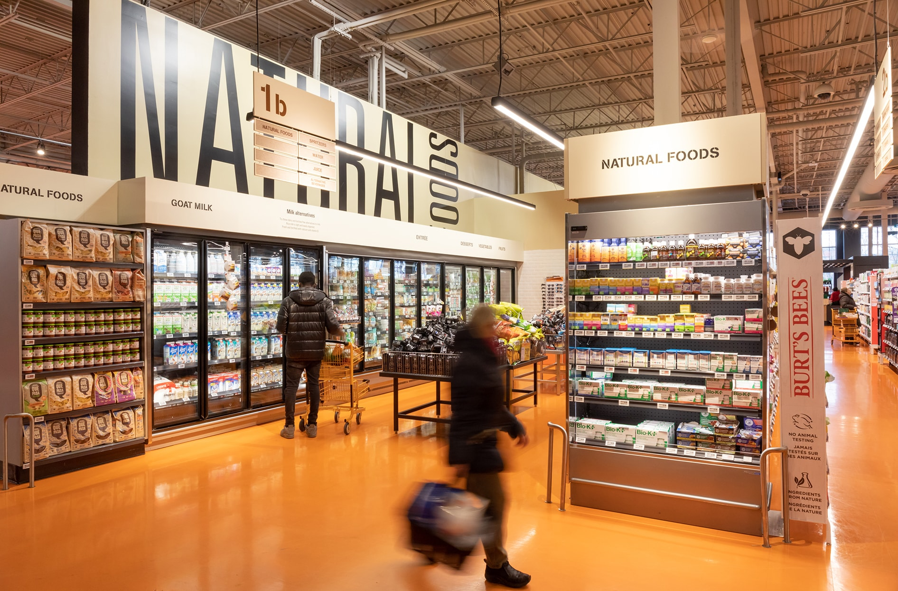
Team- 4 – Loblaws (alias used - Loblyst)
Vaishnavi Wadhwa - 8939083
Janviben Patel - 8898912
Adhil Muzahir - 8883484
Ota Adesina - 8889777
Simran Rattu - 8902253
Soji Koshy - 8940087

Slide 2






MEET THE TEAM
Vaishnavi Wadhwa
Janviben Patel
Adhil Muzahir
Project Manager
Assistant PM
Documentation
Ota Adesina
Soji Koshy
Simran Rattu
Tester
Development
Planner
Notes:
Vaishnavi Wadhwa - 8939083
Janviben Patel - 8898912
Adhil Muzahir - 8883484
Ota Adesina - 8889777
Simran Rattu - 8902253
Soji Koshy - 8940087

Slide 3
AGENDA
Executive Summary
Customer Feedback
Opportunity Identification
Stakeholders
SWOT Analysis
Gap Analysis
Business and Solution Requirements
Current Use case
Future ‘TO-BE’ Process diagram
Solution Options
Selected Solution Recommendation
Risk Analysis and Mitigation
Testing Strategy
Implementation Strategy
Database Design
Prototype webpages
Benefits of the initiative
ROI
How do we expect to see the Loblyst?

Slide 4
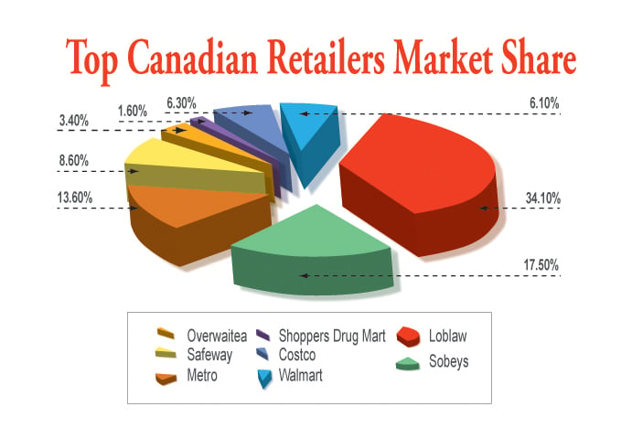
Executive Summary
Loblyst Companies Limited is Canada’s largest food retailer, operating over 2,400 stores nationwide under various banners, including Loblyst, Shoppers Drug Mart, and No Frills. The company focuses on providing customers with grocery, pharmacy, health, and beauty products while also expanding its financial services and digital offerings.
Loblyst Companies Limited (LCL) is the undisputed leader among Canadian food retailers.
But most of the Customers/ visitors are abandoning the carts, (less than 2%) they are not turning into buyers, which is a serious matter to address. Optimally it needs to be above 4%.
(UFCW, 2010, para. 3)
Notes:
Why Loblyst? Founded in 1919, with headquarters are in Brampton. No frills and Real Canadian do price match Zehers and shoopers drug mart don’t do that.

Slide 5
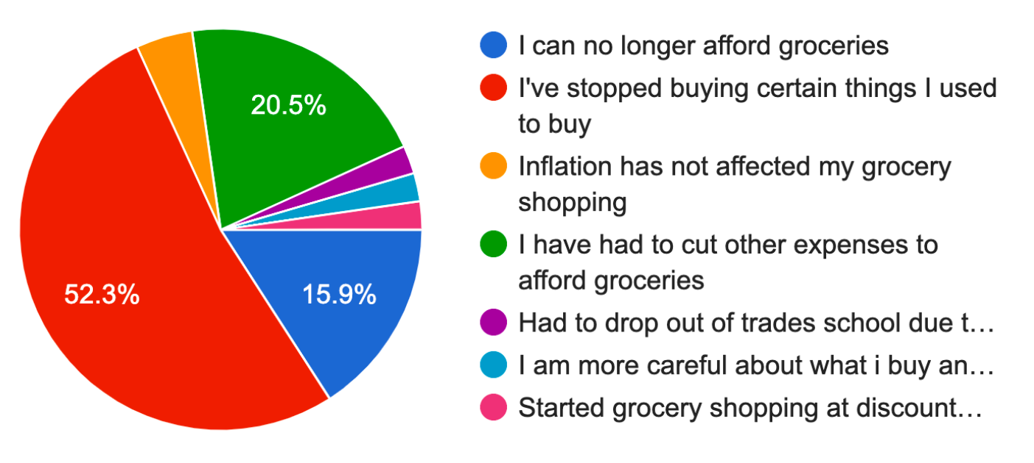
Customer Feedback
(National Trending Staff, 2023, para. 8)

Slide 6
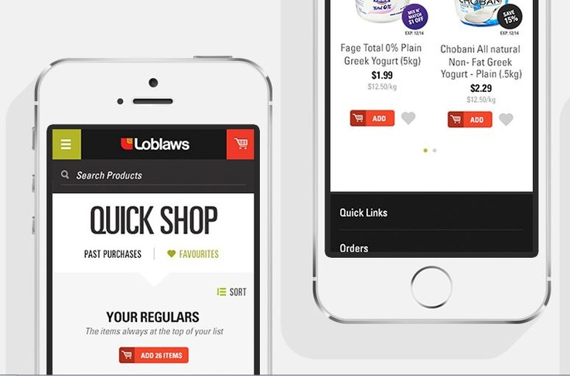
Opportunity Identification
Conversion rate: < 2%
Bounce Rate: 45-50%
Website Load Time: 11 seconds
Customer Satisfaction (CSAT): 2.5/5
Average Order rate: $80
Order fulfillment rate: 2-3 Days
Geographic Reach: Limited to specific GTA regions.
(similarweb, 2024, p. 1)

Slide 7

Stakeholders
Internal
Project Sponsor
Project Manager
Development Team
Business Analysts
User Experience (UX)/UI Designers
Marketing Team
Finance Team
IT Infrastructure Team
Customer Support Team
Stakeholder Management Team
External
Third-Party Vendors
End-Users
Regulatory Authorities
External Consultants

Slide 8
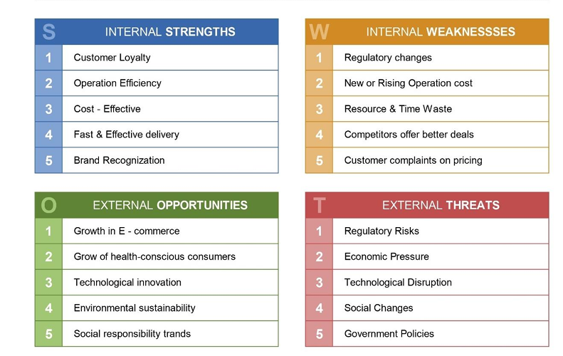
SWOT Analysis
(Team 4 , 2024a, p. 8)

Slide 9
Gap Analysis
KPI | Current Performance | Future Performance | Gap | Action Required
Website Load Time | 11 seconds | 2-5 seconds | 6-9 seconds | Enhance page loading by optimizing the assets, using content delivery networks, and image compression.
Conversion Rate | 2% | Optimally 4% for a high market share | 2% gap in conversion rate | Improve UI/X, accelerate the checkout processes, and optimize navigation to enhance the conversion rate.
Bounce Rate | 45-50% | <30% | 15-20% higher bounce rate | Enhance user experience and page loading time to retain more visitors.
Customer Satisfaction (CSAT) | 2.5 out of 5 | 4 to 4.5 | 1.5 to 2 lower customer satisfaction | Integrate loyalty programs and make checkout processes easier to enhance customer satisfaction.
Mobile Responsiveness | Average performance due to slower load times. | High responsiveness with <3 sec load time | Significant performance gap, especially on mobile | Ensure that the design is mobile-first, with responsive layouts and content optimization for mobile users.
Order Fulfillment Time | 2 to 3 Days | Same-day or next-day delivery for standard | 1-2 days slower than industry best practices | Delays in order fulfillment result in lower customer satisfaction and retention.
Geographic Reach | Limited to specific regions in Canada (GTA) | Expand to other regions | 1-5 years needed to new stores. | Streamline supply chain and expand regional delivery options to reduce fulfillment time.
Average Order Value (AOV) | $80 | > $110 | >$25 | Upselling and cross-selling, along with personalized promotions, may improve AOV.
(similarweb, 2024, p. 1)

Slide 10
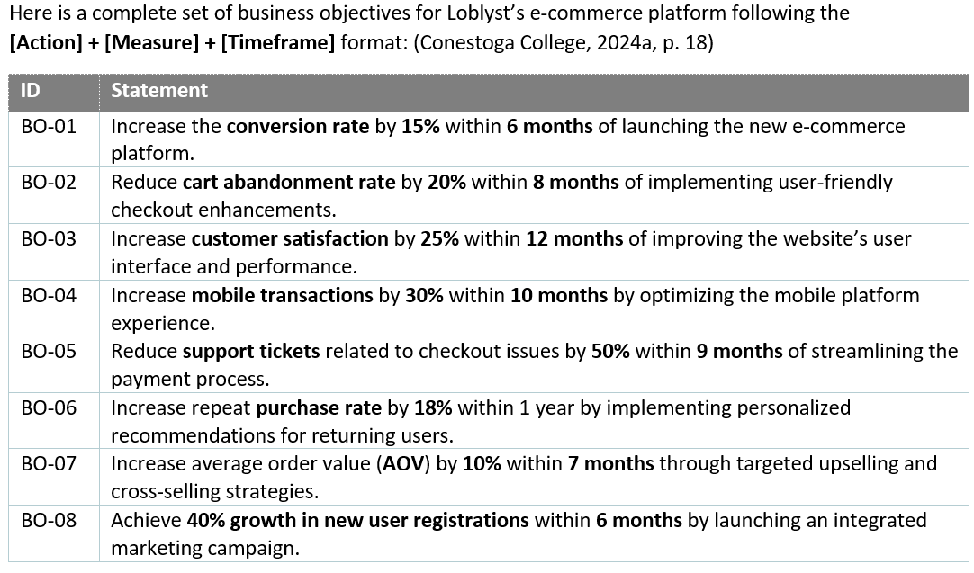
Business and Solution Requirements
(Conestoga College, 2024b, p. 18)
Notes:
Once 8 then 5, 6 lastly we can extend our market reach to KWC region.

Slide 11
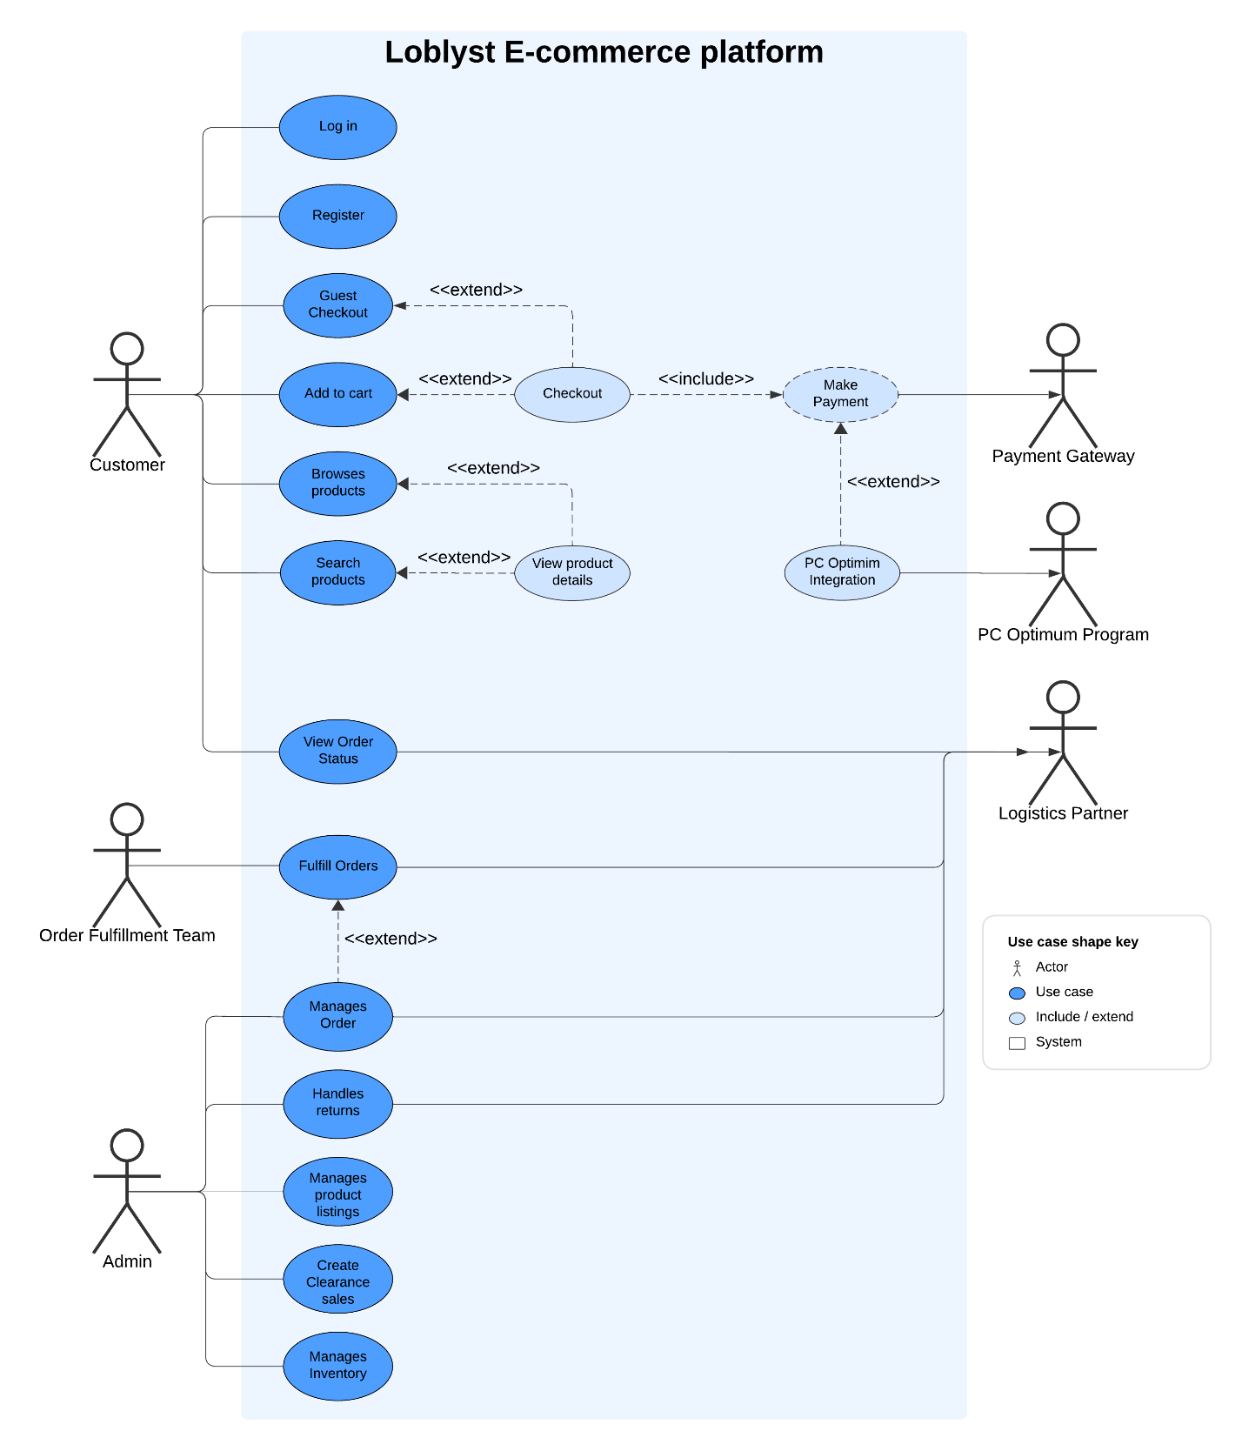
Current Use Case
(Lucidchart, 2024, p. 1)

Slide 12
Future ‘TO-BE’ Process diagram
(Loblaws, 2024, p. 1)

Slide 13
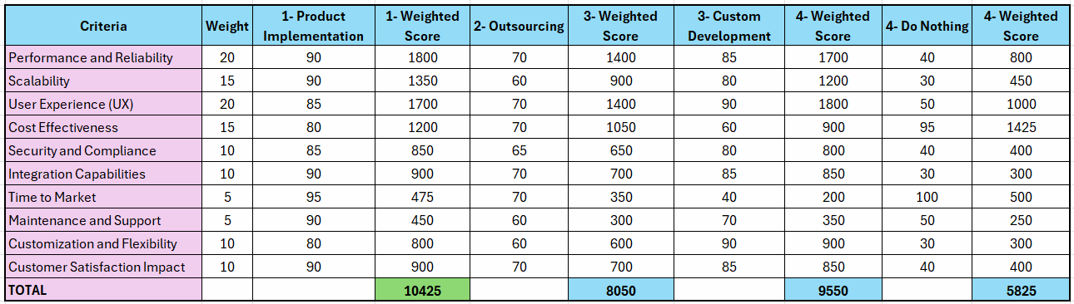
Solution Options
(Team 4, 2024e, p. 15)

Slide 14
Selected Solution Recommendation
Key Concepts
Speed of Deployment
Proven Reliability
Cost Efficiency
Continuous Upgrades
Customization within Limits
Reduced Risk
Challenges
Vendor Dependency
Integration Issues
Limited Flexibility
(Team 4, 2024e, p. 5)
Notes:
Key Concepts of Product Implementation (COTS Platform):
Speed of Deployment:
Prebuilt functionality allows rapid implementation.
Reduces time to market.
Proven Reliability:
Pretested and scalable solutions.
Trusted by other businesses.
Cost Efficiency:
Lower development and maintenance costs.
No need to hire specialized development teams.
Continuous Upgrades:
Regular updates from vendors to improve features, security, and performance.
Less internal effort required for upgrades.
Customization within Limits:
Configuration options available to tailor the platform.
Meets specific business needs without starting from scratch.
Reduced Risk:
Established solutions reduce uncertainty.
Proven functionality reduces the risk of failure.
Challenges of Product Implementation (COTS Platform):
Vendor Dependency:
Relying on the vendor for support, upgrades, and issue resolution.
Potential for service disruptions or delays if the vendor doesn’t meet expectations.
Integration Issues:
Compatibility with existing systems may require additional investment in integration tools.
Customization may be needed to fit within current workflows.
Limited Flexibility:
Less ability to modify the platform for very specific needs compared to custom-built solutions.
Might need workarounds for some unique requirements.
Hidden Costs:
Although upfront costs are lower, there could be hidden costs for integrations, training, or additional features.
Adaptation to Business Changes:
May struggle to adapt quickly to changing business needs without major updates or adjustments by the vendor.

Slide 15
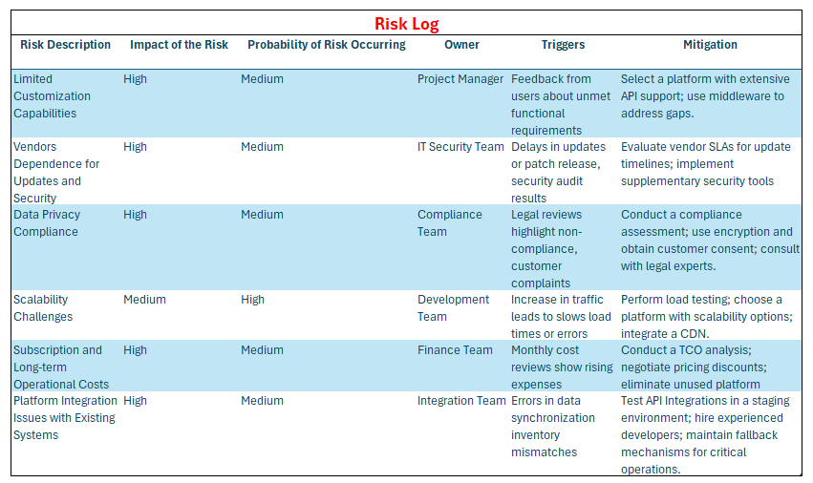
Risk Analysis and Mitigation
(Team 4, 2024f, p. 10)

Slide 16
Testing Strategy
"Through rigorous testing, we ensure Loblyst's platform delivers seamless performance, robust security, and exceptional user experiences—every time!"
Scope’s Focus
Seamless order management
Testing Levels
Unit Testing
Integration Testing
System Testing
User Acceptance Testing (UAT)
Smooth payment processing
Robust PC Optimum integration
Testing Tools
Selenium
JIRA
JMeter
Risk Mitigation
Early detection
Traffic stress testing
Vendor collaboration
Test Environment
Setup
Safety
(Team 4, 2024f, p. 13)

Slide 17
Implementation Strategy
"Strategic implementation ensures Loblyst achieves its vision of seamless scalability and customer satisfaction!"
Deployment Approach
Migration Strategy
Full Rollout
Backout Strategy
Phased Rollout
Feedback-Driven Expansion
Pilot Phase
Data Integrity
Rollback Plan
Backup
Logs
Client Involvement
Stakeholder Engagement
Train the Trainer Model
Key Considerations
System Testing
Compliance & Security
Change Management
Customer Support
(Team 4, 2024f, p. 11)

Slide 18
Database Design
(Team 4, 2024g, p. 12)

Slide 19
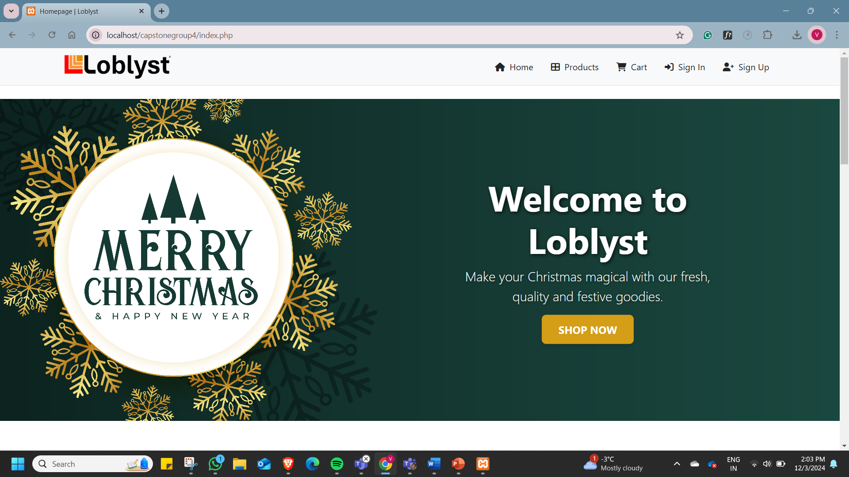

Slide 20
Key updates of prototype Updates of prototype
PC optimum optional membership
Membership in just 1 click
Benefits of being a member
Explicit differences in member prices in certain products
Easy Cart update/ Checkout Process
Now, load time is faster and guest are welcome as well !
Merging all our brands under an umbrella
To retain a customer even in out-of-stock situations.

Slide 21
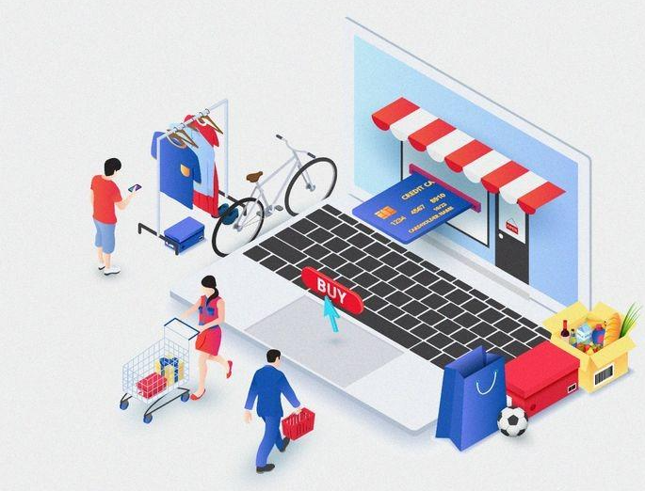
Benefits of the Initiative
Expanded Reach: Loblyst will serve more areas beyond GTA, KWC increasing market share.
Improved Performance: Faster page loads (3-5 seconds) will reduce bounce rates and boost loyalty.
Higher Conversions: Optimized design and checkout will increase online purchases by 4%.
Increased Satisfaction: Enhanced platform options will raise customer satisfaction to 4-4.5/5.
Operational Efficiency: Streamlined payment and order processes will speed up the order cycle and improve operations.

Slide 22
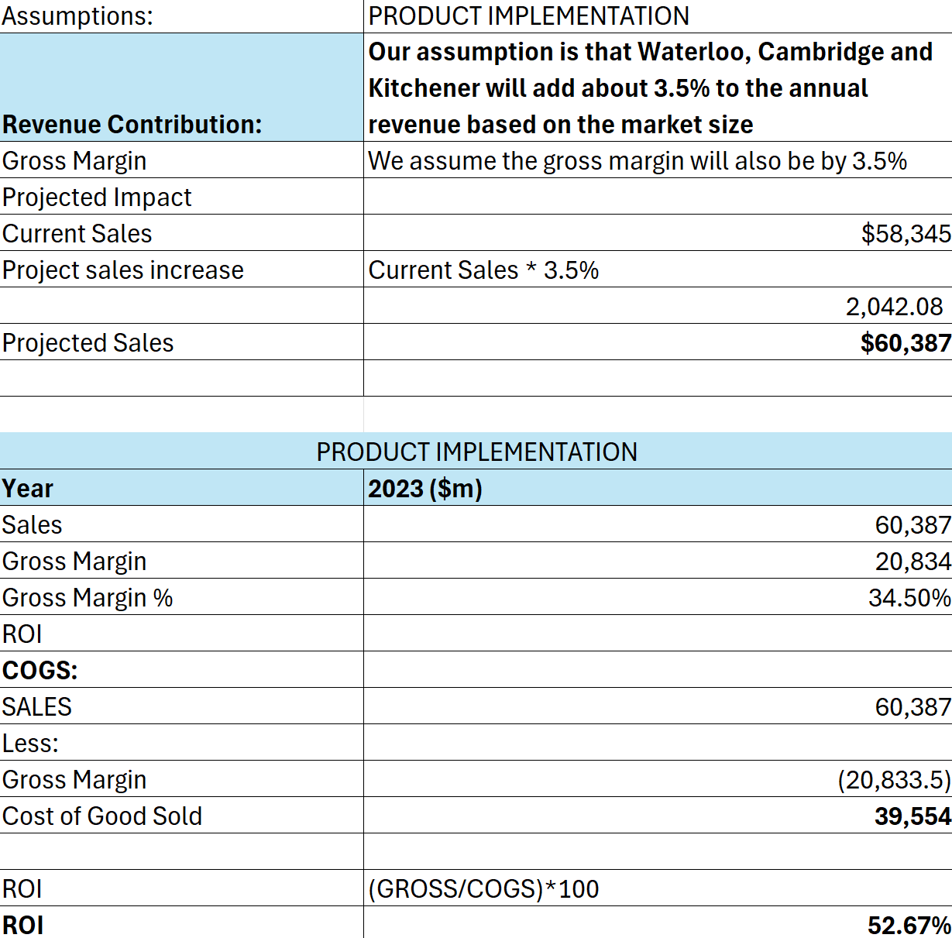
ROI
52.67%
(Team 4, 2024f, p. 8)

Slide 23
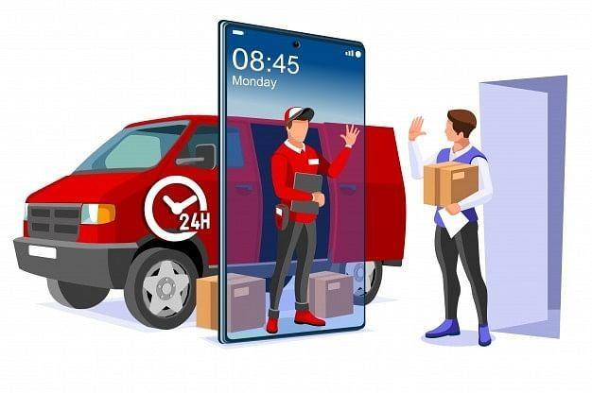
Future recommendations
Expand Market Reach (BO-08): Target the Kitchener-Waterloo-Cambridge (KWC) region to leverage regional growth opportunities.
Focus on New User Registrations (BO-08): Achieve 40% growth within 6 months to build a larger customer base.
Streamline Payment Process (BO-05): Reduce support tickets by 50% within 9 months to improve operational efficiency.
Enhance Customer Retention (BO-06): Increase repeat purchase rate by 18% within 1 year through personalized recommendations.
Notes:
Change according to 10

Slide 24
References
UFCW. (2010, July 19). Loblaws and the Canadian retail food industry. Market Share
https://www.ufcw.ca/index.php?option=com_content&view=article&id=1831:ontario-loblaw-talks-resume-after-massive-strike-mandate&Itemid=6&lang=en
National Trending Staff. (2023, Feb 23). Loblaw made a profit of $529M in three months — Its biggest moneymakers? Food and drugs. DH Canada
https://dailyhive.com/canada/loblaw-profit-q4-food-drugs
Lucid chart. (2024). Updated Use Case
https://lucid.app/lucidchart
Microsoft Visio Professional. (2024). Wireframes
https://www.microsoft.com/en-us/microsoft-365/p/visio-professional-2021/cfq7ttc0hgxw

Slide 25


